Slide 1
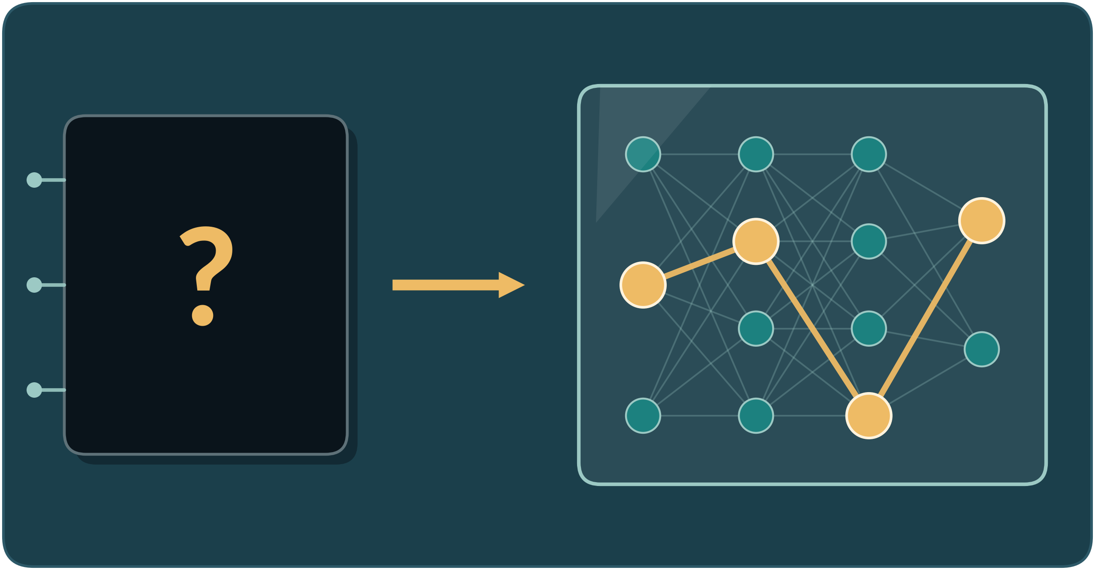
Chapter 3: Goals of Interpretability
Sivas Cumhuriyet Üniversitesi
Açıklanabilir Yapay Zeka
Chapter 3 of Interpretable Machine Learning
by Christoph Molnar
From black box to glass box
Chapter 2 | Interpretability
Presented by Tania El Hawari
Chapter 3 | Goals of Interpretability
Notes:
ENGLISH
Hi everyone, I’m Tania. Today I’m talking about the goals of interpretability. It comes from chapter 3 of Christoph Molnar’s book, Interpretable Machine Learning. I kept the book’s titles and examples, but the explanations are in my own words. One question runs through the whole talk: once we can understand a model, what do we do with that understanding?
TÜRKÇE
Herkese merhaba, ben Tania. Bugün yorumlanabilirliğin amaçlarını anlatacağım. Konu, Christoph Molnar’ın Interpretable Machine Learning kitabının 3. bölümünden geliyor. Kitaptaki başlıkları ve örnekleri korudum ama açıklamaları kendi cümlelerimle yaptım. Sunumun tamamında tek bir soru var: Bir modeli anlayabildiğimizde, bu anlayışla ne yapacağız?

Slide 2
Chapter 3: Goals of Interpretability
03
Improve the model
What do we actually want to achieve when we interpret a model?
Justify model and predictions
Discover insights
Notes:
ENGLISH
Now chapter 3. It changes the question from ‘what is interpretability’ to ‘what do we use it for’. The book names three goals: improve the model, justify the model and its predictions, and discover insights. Each goal has its own examples, and we’ll see all of them.
TÜRKÇE
Şimdi 3. bölüm. Soru, ‘yorumlanabilirlik nedir’den ‘ne için kullanıyoruz’a dönüyor. Kitap üç amaç sayıyor: Modeli geliştirmek, modeli ve tahminlerini haklı çıkarmak ve içgörü keşfetmek. Her amacın kendi örnekleri var ve hepsini göreceğiz.

Slide 3



Goals of Interpretability
Topic: Interpretability is a means to an end, and your goal decides which approach to use.
Improve the model
Justify model and predictions
Discover insights
Find mistakes and shortcuts, and make the model better.
Give other people and institutions reasons for the model and for each output.
Learn something new from the model about the data or about the model itself.
The goal decides the approach: interpretability is a means to an end
Three goals inspired by Adadi & Berrada (2018), as presented in Molnar, Chapter 3.
Notes:
ENGLISH
Chapter 3 starts with a key message: interpretability is a tool to reach something else, not a goal by itself. Your goal decides which approach fits. The three goals come from Adadi and Berrada, 2018. That paper also had a fourth idea, ‘control’, meaning debugging and finding errors, but Molnar puts it under improvement. Two small notes: people who propose new methods rarely say which goal they serve, and Molnar himself only added this chapter when the book reached its third edition.
TÜRKÇE
3. bölüm önemli bir mesajla başlıyor: Yorumlanabilirlik, başka bir şeye ulaşmak için bir araç, kendi başına bir amaç değil. Amacınız hangi yaklaşımın uygun olduğunu belirler. Üç amaç, Adadi ve Berrada’dan, 2018. O makalede dördüncü bir fikir daha vardı: ‘Kontrol’, yani hata ayıklama ve hataları bulma, ama Molnar bunu ‘modeli geliştirmek’ başlığının altına koyuyor. İki küçük not: Yeni yöntemler öneren insanlar hangi amaca hizmet ettiklerini nadiren söylüyor ve Molnar’ın kendisi bu bölümü kitabın üçüncü baskısına gelene kadar eklememiş.

Slide 4
Improving the model
Topic: Use interpretability to find problems, but check the performance metrics first.
1
Always evaluate the performance metrics first
Check the numbers first
Performance metrics tell you whether improvement is really the goal right now.
2
Ask: is improving the model my current goal?
Clever Hans shortcuts
A model can predict well using clues unrelated to the real cause.
3
If yes, use interpretability to find shortcuts and mistakes
Clever Hans predictor
A right answer for the wrong reason: the model took a shortcut
Shortcuts hide well
They often do not lower performance and may even raise it, so the score gives no warning.
Molnar, Chapter 3: improving the model and Clever Hans predictors.
Notes:
ENGLISH
Goal one: improve the model. First, always check the performance numbers, because they can tell you whether improvement should even be your goal. Then interpretability can help you find shortcuts. A ‘Clever Hans’ model gets the right answer for the wrong reason, using a clue that isn’t really related to the task. The tricky part is that these shortcuts often don’t hurt performance, and can even raise it. So the score gives no warning. Looking at the reasons behind the predictions is how you find them.
TÜRKÇE
Birinci amaç: modeli geliştirmek. Önce her zaman performans sayılarına bakın, çünkü modeli geliştirmenin gerçekten amacınız olup olmaması gerektiğini söyleyebilirler. Sonra yorumlanabilirlik kestirme yolları bulmanıza yardım edebilir. ‘Clever Hans’ modeli, doğru cevabı yanlış nedenle verir; görevle gerçekten ilgisi olmayan bir ipucu kullanır. İşin zor yanı, bu kestirme yolların çoğu zaman performansa zarar vermemesi, hatta artırabilmesi. Yani skor hiçbir uyarı vermiyor. Tahminlerin arkasındaki nedenlere bakmak, onları bulmanın yolu.

Slide 5



Clever Hans predictors: wolf or dog?
Topic: A classifier that looked at the snow instead of the animal.
A wolf-versus-dog classifier
The task is to tell wolves from dogs in pictures.
What it learned
Snow in the background was enough to predict wolf.
what the classifier looks at
Why it matters
It scored well, but for the wrong reason: a shortcut instead of the animal.
Prediction: wolf, because of the snow
Example from Ribeiro, Singh & Guestrin (2016), as cited in Molnar, Chapter 3. The tile is my own schematic, not their figure.
Notes:
ENGLISH
Here’s the first Clever Hans case. A classifier was supposed to tell wolves from dogs in photos. Ribeiro, Singh and Guestrin found that it relied on the snow in the background. If many wolf photos have snow, snow becomes an easy rule. The score looks great, but the model isn’t really looking at the animal. My picture here is a simple schematic: an animal paw, snowy ground, and a dashed box around what the model looks at. A high score doesn’t prove the model learned the right thing.
TÜRKÇE
İşte ilk Clever Hans vakası. Bir sınıflandırıcı, fotoğraflarda kurtları köpeklerden ayıracaktı. Ribeiro, Singh ve Guestrin, arka plandaki karı kullandığını buldu. Kurt fotoğraflarının çoğunda kar varsa, kar kolay bir kural olur. Skor harika görünür ama model aslında hayvana bakmıyor. Buradaki resim benim yaptığım basit bir şema: Bir hayvan pati izi, karlı zemin ve modelin baktığı yeri çevreleyen kesikli bir kutu. Yüksek skor, modelin doğru şeyi öğrendiğini kanıtlamaz.

Slide 6
Clever Hans predictors: asthma and pneumonia
Topic: Missing information about treatment created a misleading risk pattern.
An asthma patient comes in with pneumonia
A surprising prediction
The model said asthma patients with pneumonia are less likely to die, though asthma is a risk factor.
got stronger antibiotics, and sooner
Fewer severe cases: lower death risk in the data
What was missing
Asthma patients received earlier, more intensive treatment, affecting outcomes.
The model saw asthma, but not the treatment that followed
It learned: asthma = lower risk (an unwanted shortcut)
A misleading shortcut
Without treatment data, asthma looked protective even though it was not.
Example from Caruana et al. (2015), as cited in Molnar, Chapter 3 (footnote 3).
Notes:
ENGLISH
The second case is about asthma and pneumonia. A model looked at patients arriving at the emergency room with pneumonia, and it said the ones with asthma had a lower chance of dying. That’s odd, because asthma is a known risk factor. The explanation: doctors treated these patients sooner and more intensively with antibiotics, so their pneumonia was usually less severe. The model never saw that later treatment, so it took a shortcut and learned ‘asthma means lower risk’. The researchers noticed this only because the model was interpretable. The pattern was real in the data, but it would be dangerous to use in medical decisions.
TÜRKÇE
İkinci vaka astım ve zatürre hakkında. Bir model, acil servise zatürreyle gelen hastalara bakıp astımı olanların ölme ihtimalinin daha düşük olduğunu söyledi. Bu garip, çünkü astım bilinen bir risk faktörü. Açıklama şu: Doktorlar bu hastaları daha erken ve daha yoğun antibiyotikle tedavi etti, bu yüzden zatürreleri genelde daha hafif seyretti. Model bu sonraki tedaviyi hiç görmedi, bu yüzden kestirme bir yol öğrendi: ‘Astım, daha düşük risk demek.’ Araştırmacılar bunu ancak model yorumlanabilir olduğu için fark etti. Örüntü verinin içinde gerçekti ama tıbbi kararlarda kullanmak tehlikeli olurdu.

Slide 7
Improving the model: debugging
Topic: Clues from an interpretation that point to a bug in the pipeline.
SIMPLE BUGS
Target feature encoded wrongly
Error in feature engineering
Debugging with interpretation
It helps find unwanted shortcuts and other mistakes in the model.
CLUES AND LIKELY CAUSES
Some bugs are simple
A wrongly encoded target or an error in feature engineering can be enough.
Feature effects contradict domain knowledge
The target classes could be switched
Ask your domain knowledge
A mismatch between model and expert knowledge, or an ignored key feature, hints at a bug.
A feature you know is important is not used
Perhaps something broke while preparing the data or building features
Molnar, Chapter 3: improving the model.
Notes:
ENGLISH
Interpretation is also a debugging tool. Some bugs are very simple: the target column is coded wrongly, or there’s a mistake in feature engineering. The explanations can give you clues. If the feature effects go against what you know about the field, maybe you swapped the target classes. If a feature you know matters never shows up in the model, maybe something broke in the data preparation or in building the features. So you compare what the model shows with your domain knowledge, and you look for the bug where the two disagree.
TÜRKÇE
Yorumlama aynı zamanda bir hata ayıklama aracı. Bazı hatalar çok basit: Hedef sütun yanlış kodlanmış ya da özellik mühendisliğinde bir yanlışlık var. Açıklamalar size ipucu verebilir. Özellik etkileri alandaki bilginize ters düşüyorsa, belki hedef sınıfları ters çevirmişsinizdir. Önemli olduğunu bildiğiniz bir özellik modelde hiç görünmüyorsa, belki veri hazırlığında ya da özellikleri oluştururken bir şey bozulmuştur. Yani modelin gösterdiğini alan bilginizle karşılaştırırsınız ve ikisinin ayrıştığı yerde hatayı ararsınız.

Slide 8

Improving the model: feature engineering
Topic: Using feature importance to get ideas for better features in a competition.
A water supply competition
The author joined a competition to predict the water supply.
What importance showed
Mountain snowfall ranked first in importance.
snow melting in the mountains fills the rivers
Feature importance: snow ranks first
Try other snow data sources
Invest in feature engineering: better performance
What he did next
He tried other snow data sources and invested in feature engineering, which improved performance.
Example from Molnar, Chapter 3: the author's water supply competition. Mountains are my own sketch.
Notes:
ENGLISH
Molnar also used interpretation in competitions, to get ideas for new features. In a competition about predicting water supply, feature importance showed that snow on the nearby mountains mattered most. So he tried other snow data sources, hoping to improve that feature, and spent time on feature engineering. That paid off: the model improved. The recipe is simple: see what matters, improve that information, and measure again.
TÜRKÇE
Molnar yarışmalarda da yorumlamayı kullandı, yeni özellik fikirleri almak için. Su arzını tahmin etme yarışmasında, özellik önemi (feature importance), çevredeki dağlardaki karın en önemli özellik olduğunu gösterdi. Bunun üzerine başka kar veri kaynaklarını denedi, o özelliği iyileştirmeyi umarak, ve özellik mühendisliğine zaman harcadı. Bu karşılığını verdi: Model iyileşti. Tarif basit: Neyin önemli olduğuna bak, o bilgiyi iyileştir ve yeniden ölç.

Slide 9






Justify model and predictions
Topic: Giving others the reasons behind a model and each of its outputs.
Creators
Design the system and fit the model
Operators
Work with the system directly
Executors
Act on what the model outputs
Decision subjects
Live with the consequences
Auditors
Inspect how the system behaves
Data subjects
People whose records fed the training
Each group may need a very different kind of justification
Stakeholder roles from Tomsett et al. (2018), as presented in Molnar, Chapter 3.
Notes:
ENGLISH
Goal two is justification: showing other people or organizations why the model, and each of its predictions, can be trusted. It helps to think about who the stakeholders are. Tomsett and colleagues list six. Creators are the team that designs and trains it. Operators work with it directly. Executors act on what it says. Decision subjects are the people who live with the results. Auditors check how it behaves. Data subjects are the people behind the training data. All of them want a justification, but each may need a very different kind.
TÜRKÇE
İkinci amaç, haklı çıkarma: modelin ve her tahmininin neden güvenilebilir olduğunu başkalarına ya da kurumlara göstermek. Paydaşların kim olduğunu düşünmek işe yarıyor. Tomsett ve arkadaşları altı tane sayıyor. Geliştiriciler (creators), sistemi tasarlayıp eğiten ekip. Operatörler (operators), sistemle doğrudan çalışanlar. Uygulayıcılar (executors), sistemin söylediğine göre hareket edenler. Karardan etkilenenler (decision subjects), sonuçlarla yaşayan insanlar. Denetçiler (auditors), sistemin nasıl davrandığını kontrol edenler. Veri sahipleri (data subjects) ise eğitim verisinin arkasındaki insanlar. Hepsi bir gerekçe istiyor ama her birinin ihtiyacı çok farklı olabilir.

Slide 10
Justify: the water supply forecast
Topic: Officials who act on a forecast need to see why it says what it says.
BOOK EXAMPLE: water supply
The model forecasts an unusually low water supply
The competition's deliverable
Written reports on the forecasts, aimed at hydrologists and officials: the executors.
1
2
Officials may need drought contingency plans and new water allocations
Do not trust blindly
An explanation lets officials check whether the forecast seems plausible.
3
Before acting, they read why this prediction was made
Domain knowledge as a test
If the reasons clash with expert knowledge, the forecast deserves a second look.
4
If the reasons conflict with domain knowledge: question the forecast and investigate
Example from Molnar, Chapter 3: reports for the author's water supply competition.
Notes:
ENGLISH
The water supply example. In the competition, one deliverable was reports explaining the forecasts, written for hydrologists and officials, the executors. Suppose a forecast says water will be unusually scarce. Officials might then have to issue drought plans and change how water is shared. Before doing that, they don’t want to just trust the number. They want to read why this forecast was made. If the explanation doesn’t match what experts know, they can doubt the forecast and look deeper. It makes the decision more transparent, but it doesn’t guarantee the prediction is right.
TÜRKÇE
Su arzı örneği. Yarışmada teslim edilecek şeylerden biri, tahminleri açıklayan raporlardı; hidrologlar ve yetkililer, yani uygulayıcılar için yazılmıştı. Bir tahminin, suyun olağandışı derecede kıt olacağını söylediğini varsayalım. Yetkililer kuraklık planları yayınlamak ve suyun paylaşımını değiştirmek zorunda kalabilir. Bunu yapmadan önce sadece sayıya güvenmek istemezler. Bu tahminin neden yapıldığını okumak isterler. Açıklama uzmanların bildikleriyle uyuşmuyorsa, tahminden şüphe edip daha derine inebilirler. Bu, kararı daha şeffaf yapar ama tahminin doğru olduğunu garanti etmez.

Slide 11
Justify: loan rejection and recourse
Topic: A person can only contest a rejection if someone can say why it happened.
BOOK EXAMPLE: loan rejection
A person applies for a loan
Contesting needs interpretability
To challenge a prediction, someone must be able to say why it was made.
1
2
The machine learning system rejects the application
Who needs it
The person affected by the rejection, called the decision subject.
3
The decision subject asks: why was I rejected?
Recourse
The book uses this word for the chance to contest a decision, based on a justification.
4
A justification lets the person contest the decision. This is recourse.
Example from Molnar, Chapter 3: a rejected loan application.
Notes:
ENGLISH
More generally, to challenge a decision from a machine learning system, you need interpretability. Think about a rejected loan. For the person, the decision subject, to contest the rejection, someone has to explain why it happened. The book calls this recourse. Without an explanation, a person can only accept the answer. With one, they can see what the decision was based on and push back.
TÜRKÇE
Daha genel olarak, bir makine öğrenmesi sisteminin kararına itiraz etmek için yorumlanabilirliğe ihtiyacınız var. Reddedilen bir krediyi düşünün. Kişinin, yani karardan etkilenenin, reddi sorgulayabilmesi için birinin bunun neden olduğunu açıklaması gerekir. Kitap buna itiraz ve çözüm hakkı (recourse) diyor. Açıklama olmadan insan sadece cevabı kabul edebilir. Açıklamayla ise kararın neye dayandığını görüp karşı çıkabilir.

Slide 12
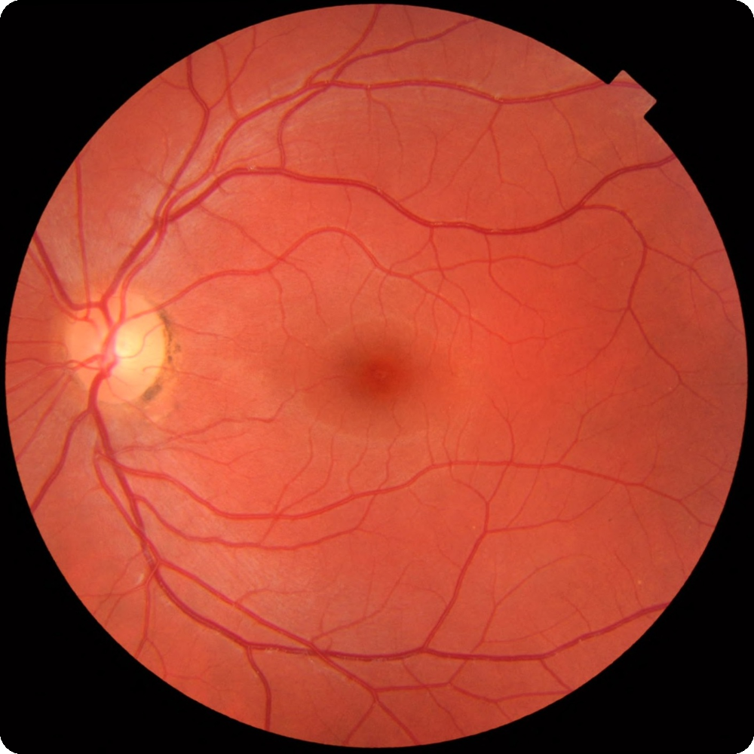
Justify: a medical device
Topic: Interpretability helps regulators review a medical model alongside other evidence.
Regulators (auditors) approve or reject the device
Regulated products
Medical devices need evidence of safety and effectiveness.
A device with ML needs evidence that its model performs safely
Machine learning adds questions
Reviewers need evidence that the model performs as intended.
Interpretability supports the review but is not enough by itself
Real retina photograph: illustrates medical-image data, not the device in the book
Interpretability is one part
Explanations can support a review, alongside validation and testing.
Testing and safety evidence are still required
Example from Molnar, Chapter 3. Photo: scikit-image sample dataset (real retina photograph), used only to illustrate medical-image data.
Notes:
ENGLISH
Another example: a company building a medical device. Before it can sell the device, it has to prove to regulators that it’s safe and effective. With machine learning inside, there’s an extra step: the company must also show that the model really does what it’s supposed to do. Interpretability can help make that case to the auditors who decide whether the device gets approved. But explanations alone don’t prove safety. You still need testing and validation. The retina photo is just an example of medical data, not the device from the book.
TÜRKÇE
Bir örnek daha: tıbbi cihaz geliştiren bir şirket. Cihazı satmadan önce düzenleyicilere onun güvenli ve etkili olduğunu kanıtlaması gerekir. İçinde makine öğrenmesi varsa ekstra bir adım olur: Şirket modelin gerçekten yapması gerekeni yaptığını da göstermeli. Yorumlanabilirlik, cihazın onaylanıp onaylanmayacağına karar veren denetçilere bu durumu anlatmaya yardım edebilir. Ama açıklamalar tek başına güvenliği kanıtlamaz. Hâlâ test ve doğrulamaya ihtiyaç var. Retina fotoğrafı sadece tıbbi veriye bir örnek, kitaptaki cihaz değil.

Slide 13
Discover insights
Topic: Models can also be used to learn, not only to predict.
BOOK EXAMPLE: churn
The model predicts how likely a customer is to cancel a mobile phone contract
A prediction is not enough
Models can also drive decisions or help study how features connect to the target.
1
2
The marketing team plans its campaigns with this prediction
Churn prediction
It estimates the chance that a customer ends a phone contract.
3
Open question: why is this customer likely to leave?
Why it matters
Without knowing why, it is hard to design an effective response.
4
Knowing the reasons makes an effective response possible
Example from Molnar, Chapter 3: churn prediction.
Notes:
ENGLISH
Goal three: discover insights. Models aren’t only used to predict. They can also support decisions, or help us study how features relate to the target. In either case, a prediction alone isn’t enough, and we want more knowledge from the model. Take a churn model. It tells you how likely it is that a customer will quit their phone plan. The marketing team might use it to plan campaigns. But if nobody knows why a customer is likely to leave, it’s tough to plan a response that works.
TÜRKÇE
Üçüncü amaç: içgörü keşfetmek. Modeller sadece tahmin için kullanılmaz. Kararları da destekleyebilir ya da özelliklerin hedefle nasıl ilişkili olduğunu incelememize yardım edebilir. Her iki durumda da tek başına bir tahmin yetmez ve modelden daha fazla bilgi isteriz. Bir müşteri kaybı (churn) modelini düşünün. Bir müşterinin telefon hattını bırakma ihtimalinin ne kadar olduğunu söyler. Pazarlama ekibi bunu kampanya planlamak için kullanabilir. Ama müşterinin neden ayrılabileceğini kimse bilmiyorsa, işe yarayan bir karşılık planlamak zor.

Slide 14
Discover insights: almond yields
Topic: Interpretation helps study relationships learned by a prediction model.
Almond yields
Zhang et al. (2019) trained random forests on orchard data, with fertilizer as an input, to forecast almond yield.
Fertilizer use
Random forest
Predicted almond yield
Other features
Beyond prediction
Researchers examined relationships between inputs and predicted yield.
Interpretability methods
Show how inputs such as fertilizer affect the model's predictions
A useful distinction
Model associations do not by themselves prove cause and effect.
Example from Zhang et al. (2019), as presented in Molnar, Chapter 3. Diagram is my own.
Notes:
ENGLISH
The almond example. Zhang and colleagues trained random forests to forecast how many almonds an orchard produces, using inputs like how much fertilizer was used. The forecast was useful, but they didn’t stop there. They applied interpretation methods to see how each input, fertilizer included, moves the predicted yield. Without that step, you’d only have a black box that spits out numbers. With it, you can see the relationships the model learned, and that suggests questions for further study. It doesn’t prove, though, that changing the fertilizer would cause the same change in real life.
TÜRKÇE
Badem örneği. Zhang ve arkadaşları, bir bahçenin kaç badem üreteceğini tahmin etmek için rastgele ormanlar (random forest) eğitti; girdiler arasında ne kadar gübre kullanıldığı gibi şeyler vardı. Tahmin işe yaradı ama orada durmadılar. Gübre dahil her girdinin tahmin edilen verimi nasıl değiştirdiğini görmek için yorumlama yöntemleri uyguladılar. Bu adım olmadan elinizde sadece sayı üreten bir kara kutu olurdu. Bu adımla modelin öğrendiği ilişkileri görebilirsiniz ve bu, daha ileri çalışmalar için sorular doğurur. Yine de gübreyi değiştirmenin gerçek hayatta aynı değişikliğe yol açacağını kanıtlamaz.

Slide 15
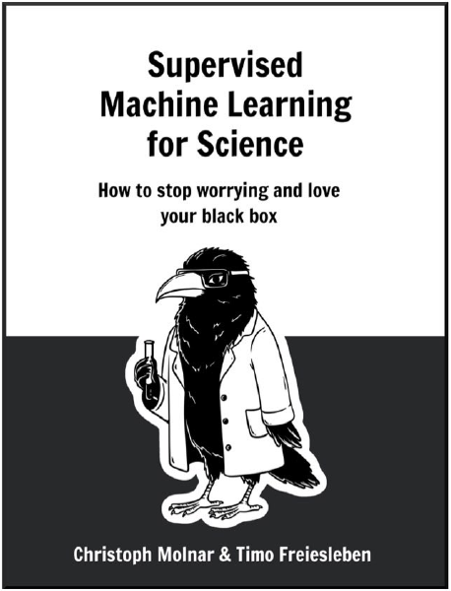
How to use machine learning in science
Topic: A deeper question that has its own book.
A deeper question
Using machine learning in science needs more than thinking about interpretability.
A whole book about it
Molnar and Freiesleben wrote a book on justifying machine learning for science.
Free to read
Supervised Machine Learning for Science: how to stop worrying and love your black box. See ml-science-book.com.
Book cover: Molnar & Freiesleben, Supervised Machine Learning for Science (as shown in Molnar, Chapter 3).
Notes:
ENGLISH
Using machine learning for science raises bigger, almost philosophical questions. Interpretability alone can’t answer them. So Molnar teamed up with Timo Freiesleben and wrote a whole book on that topic. It’s called Supervised Machine Learning for Science, with the subtitle ‘How to stop worrying and love your black box’. It’s free at ml-science-book.com. The picture is its cover.
TÜRKÇE
Bilimde makine öğrenmesini kullanmak daha büyük, neredeyse felsefi sorular doğuruyor. Yorumlanabilirlik tek başına bunları cevaplayamaz. Bu yüzden Molnar, Timo Freiesleben ile birlikte bu konuda koca bir kitap yazdı. Adı Supervised Machine Learning for Science, alt başlığı ‘How to stop worrying and love your black box’, yani ‘Kara kutunuzu sevmeyi öğrenin’. ml-science-book.com adresinde ücretsiz. Gördüğünüz resim kitabın kapağı.

Slide 16

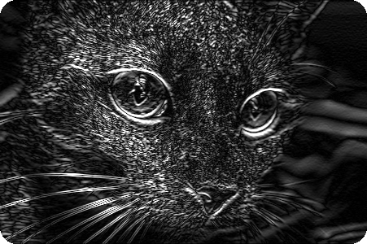
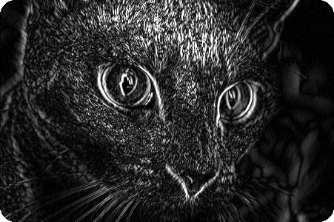
Learning about the model: CNN neurons
Topic: Interpretability can teach us about the model, not only about the data.
Learning about the model
Interpretability helps with learning about the model itself, not only about the data.
Input photo
Horizontal edges
Vertical edges
Neurons and concepts
For convolutional neural networks we can study what concepts single neurons react to.
These edge maps illustrate simple visual patterns, not actual CNN neuron outputs
Why it helps
This can reveal internal patterns that influence the network's output.
Interpretability asks: which concept does each neuron react to?
Idea from Molnar, Chapter 3. Photo: scikit-image sample image (public domain). Edge maps computed with Sobel filters: an illustration, not a figure from the book.
Notes:
ENGLISH
The last example: we can learn about the model itself, not only about the data. For a convolutional neural network, one question is what kind of patterns each neuron reacts to. The cat photo and the two edge images are only an illustration of detecting simple patterns. I made them with ordinary image filters, so they’re not real neuron outputs. Interpretability can show us what concepts a network has learned inside.
TÜRKÇE
Son örnek: Sadece veriyi değil, modelin kendisini de öğrenebiliriz. Bir evrişimli sinir ağında (CNN) bir soru, her nöronun ne tür örüntülere tepki verdiği. Kedi fotoğrafı ve iki kenar görüntüsü, sadece basit örüntüleri tespit etmenin bir örneği. Bunları sıradan görüntü filtreleriyle yaptım, yani gerçek nöron çıktıları değiller. Yorumlanabilirlik, bir ağın içinde hangi kavramları öğrendiğini gösterebilir.

